Slide 1


WP4
Creative use of AI
in Education
Centre for AI and Creativity
MishMash
Senter for KI og kreativitet

Slide 2
?
How can Creative AI be integrated into education to enhance learning and foster AI literacy while considering diversity, justice, inclusion and well‐being?

Slide 3
RQ4.1: How can Creative AI be effectively integrated to enhance teaching and learning and foster human creativity?
RQ4.2: How can the artistic use of AI within creative and fine arts education challenge and develop hierarchies of knowledge production in education and research?
RQ4.3: What measures can ensure that ethical considerations such as diversity, justice, fairness, inclusion, privacy, trust, and accessibility are central to implementing AI in creative education?
RQ4.4: How can the relationship between AI in formalised education and the application of AI in broader artistic practice be mapped and analysed to advance the use of Creative AI?

Slide 4
EXPLORE the artistic and pedagogical use of AI in formal, non‐formal and informal learning contexts, including developing a shared understanding of AI literacy for creative and fine arts education.
REFLECT on the implications of using AI in education to suggest frameworks and policy recommendations for using AI in education.
CREATE educational material, models and methods for broad applications through artistic and pedagogical practices with AI, emphasising ethical issues related to diversity, justice, fairness, inclusion, privacy, trust and accessibility.

Slide 5
Knowledge
Practices
Resources
Policy

Slide 6
Deliverables
Knowledge
Equip future practitioners and educators with the competence to navigate AI’s complexities.
Unify efforts to advance AI literacy in Norwegian schools and enhance the understanding and application of Creative AI in higher education and lifelong learning
Practices
External Funding
Exploration of pedagogical use of AI in formal, non‐formal and informal learning contexts
Further funding such as Erasmus+ and Nordplus, to facilitate cross‐sectoral educational collaboration
Educational material, models and methods for broad applications through artistic and pedagogical practices with AI.
Resources
Providing current educators with resources to minimize a generational gap in AI literacy
Frameworks and policy recommendations for AI in creative-and arts education
Policy

Slide 7
WP4 goal
(contribute to)
Creative educations characterized by
critical, informed and deliberate relationships and collaborations with AI systems
[Field] characterized by [adjectives][relations] with [AI].
Notes:
Wo don’t have to agree on all the terms here, but it can be a starting point, and you can find you own particular formulations and use your own particular terminology.
[The field] characterized by [good][relations] with [AI].
For example: Artistic educations characterized by creative and critically informed use of AI.

Slide 8
Goal for today
Focus areas / hubs
Projects
Roadmap
Practicalities

Slide 9
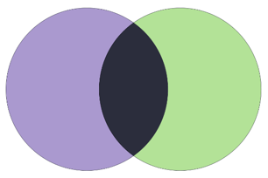
Introductions
Max. 2 minutes each
Name, institution Disciplin
Main area(s) of interest and contribution

Slide 10
Areas of interests
Scoping review
Critical AI literacy
Developing dissemination platforms
Immediate resources
How AI influences of immersion
EdTech in education
Analysis of human-AI interactions/conversations
Interactive books
Culture schools
Video

Slide 11
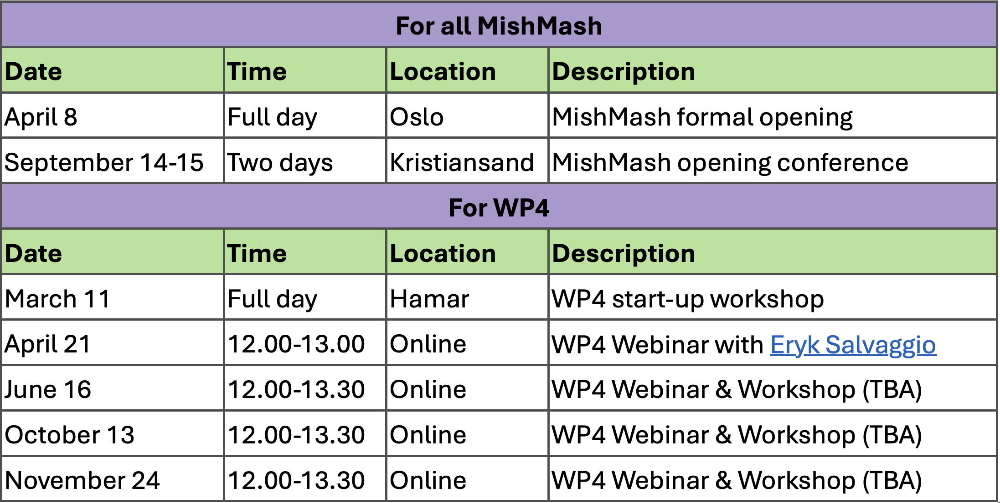
Frequency

